Slide 1

Notation
Sums and recurrences
Manipulation of sums
Multiple sums
General Method

Slide 2

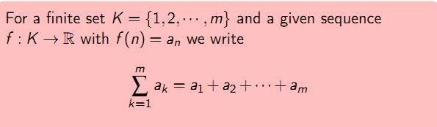
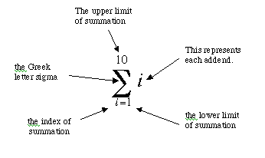

Slide 3



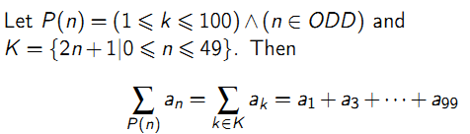

1
2
3
4

Slide 4


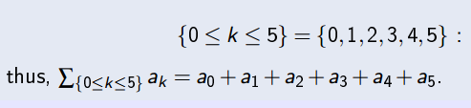

Compute the sum for
What is the first sum?
Then second one?

Slide 5

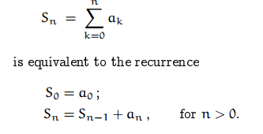
Therefore we can evaluate sums in closed form.

Slide 6

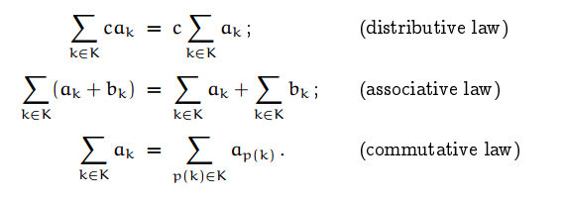
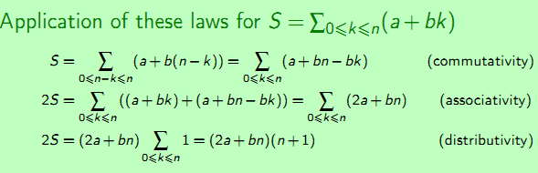

Slide 7

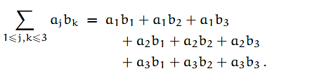


Slide 8
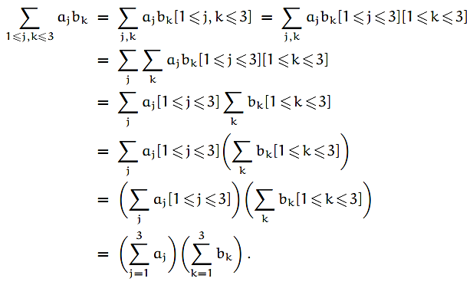

Slide 9


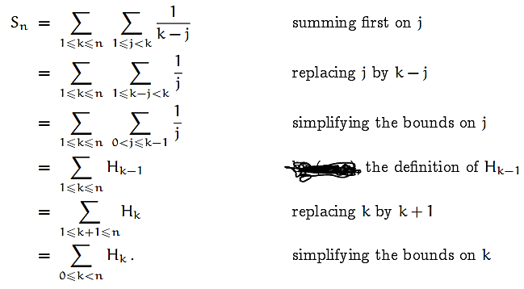

Slide 10

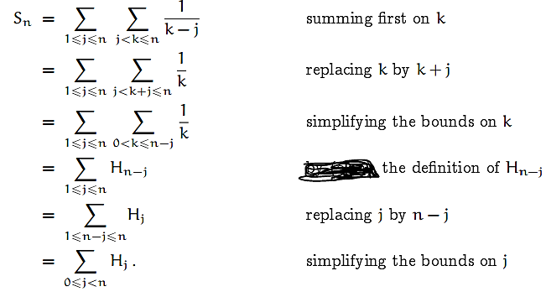

Slide 11

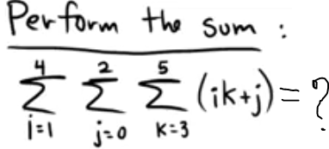
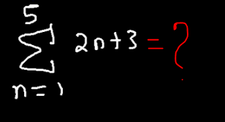

Find the sum
Find the sum

Slide 12





Slide 13

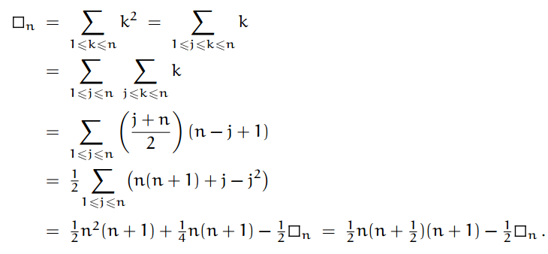
Many ways to discover sum,
  Follow Expand and contract

Slide 14
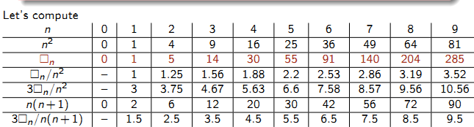




Slide 15


Discover the formula for:
Solve the exercises: 4, 11, 14, 15.

